Slide 1


Slide 2

GROUP 4 –
THOMASCOOK

Slide 3




Contents
Our Team
Introduction
Thomascook Overview
Technologies Used
Architecture
Structure and Work BreakDown
Challenges, Results and Learnings
Conclusion

Slide 4



Team
Suryanshu Verma
(React)
Tanishka Sati
(React)
Hardik Agarwal
(DevOps)
Saransh Pathak
(Java)
Prakarsh Kaushik
(Java)
Pratham Maheshwari
(Java)
Saijal Gupta
(Java)
Amandeep Srivastava
(Java)
Nikhil Srivastava
(React)
Fahim Abbasi
(DevOps)

Slide 5
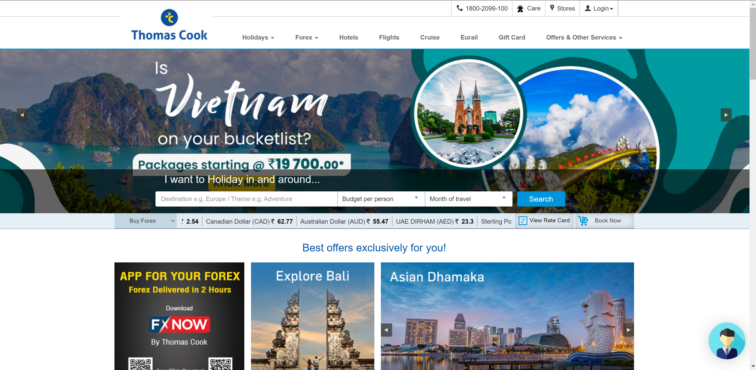
Introduction
Welcome to the Thomas Cook Website Clone Project!
In this presentation, we will outline the key aspects of our ambitious project to recreate the Thomas Cook website, detailing the scope, technologies, and strategies involved.

Slide 6

This project holds immense significance as it aims to improve our skills and develop a project that tap into the travel and tourism market, offering users a reliable and user-friendly platform for planning their trips.
Our main goals are to capture a similar user interface, offer a range of travel services, and deliver an exceptional user experience that mimics the original Thomas Cook website.

Slide 7


Thomascook Overview
Thomas Cook is a renowned travel and tourism company with a rich history dating back to 1841. It has been a trusted name in the industry for over a century.
The original Thomas Cook website provided a wide range of travel services, including flight bookings, hotel reservations, vacation packages, cruises, and more.
The original Thomas Cook website provided a wide range of travel services, including flight bookings, hotel reservations, vacation packages, cruises, and more.
In the following slides, we will delve into the details of how we plan to replicate the essence of Thomas Cook's services and user experience through our clone project.

Slide 8




Technologies Used
Java 17:
We have chosen Java 17 as the programming language for our backend development. Java is renowned for its reliability, scalability, and strong community support. Version 17 brings the latest features and improvements.
Spring Boot 3.1.3:
Our backend development will be powered by Spring Boot, a leading framework for building robust and efficient web applications. Spring Boot simplifies development and offers a wide range of tools and libraries.
MySQL 8.0.34:
For data storage and management, we have opted for MySQL 8.0.34, a trusted relational database management system. It provides a secure and stable environment for handling data.
React:
On the frontend, we are using React, a popular JavaScript library for building user interfaces. React's component-based architecture allows for the creation of dynamic and responsive web pages.

Slide 9
Technologies Used
Additional Technologies:
We leveraged a host of complementary technologies and tools, including:
Redux: For state management in React, ensuring efficient data flow within the application.
Webpack: For bundling and optimizing our frontend assets.
Axios: A promise-based HTTP client for making asynchronous requests to our backend.
JWT Authentication: To ensure secure user authentication and authorization.
Swagger: For API documentation, making it easier for developers to interact with our backend services.
Scalability and Compatibility:
This technology stack has been carefully chosen to ensure scalability, performance, and compatibility with modern web development standards. It enables us to build a robust and efficient clone of the Thomas Cook website.
Development Flexibility:
Our technology stack allows for flexibility in development, ensuring that we can adapt to changing requirements and industry trends.
Next Steps:
In the upcoming slides, we will dive deeper into the design and development aspects, highlighting how these technologies come together to create an exceptional user experience.

Slide 10

Architecture
Frontend Layer:
User Interface (UI): This layer includes the web pages and user interfaces visible to the end-users.
Home Page: The main landing page where users can navigate to different sections of the website.
Hotel Booking: A section for users to search and book hotels based on their preferences.
Flight Booking: A section for users to search and book flights to various destinations.
Holiday Booking: A dedicated area for users to explore and book holiday packages.
Static Pages: Including "About Us" to provide information about the company and "Gift Cards" to purchase or redeem gift cards.
User Authentication: Registration and login functionality for user accounts.
User Dashboard: A personalized area where users can manage bookings, and do account settings.
React Library: Utilized for building dynamic and responsive user interfaces.
Redux State Management: Used for managing application state, especially when handling complex booking processes.

Slide 11
Architecture
Backend Layer:
API Server: Serves as the bridge between the frontend and backend systems.
Hotel Booking API: Handles hotel search, availability, and booking requests.
Flight Booking API: Manages flight search, availability, and booking operations.
Holiday Booking API: Facilitates holiday package search, details retrieval, and booking.
User Management API: Handles user registration, login, and account management.
Spring Boot (Java 17): Utilized for building robust and scalable backend services.
MySQL Database: Stores user data, booking records, and other application data.
Authentication and Authorization: Ensures secure access to user accounts and protected API endpoints.

Slide 12
Architecture
External Services:
Payment Gateway Integration: Integration with a Razorpay payment gateway for dummy processing transactions securely.
Infrastructure Layer:
Web Servers: Host the website and API endpoints.
Load Balancers: Distribute incoming web traffic evenly across multiple servers for improved performance and reliability.
Database Servers: Host and manage the MySQL database.
Cloud Hosting (e.g., Netlify, webapp.io): Scalable infrastructure for reliability and performance.

Slide 13

Workbreakdown – Backend Modules
Our backend development is divided into four distinct modules to efficiently handle different aspects of our travel booking website.
Hotel Booking Module:
Functionalities/Use Cases:
Hotel Search: Users can search for hotels based on location, check-in/out dates, and preferences.
Room Booking: Users can book rooms, specifying room type and quantity.
Price Calculation: Calculates the total price including taxes and additional charges.
Reservation Confirmation: Generates booking confirmations after payment.
User Reviews: Allows users to view & leave reviews, ratings for hotels.
Flight Booking Module:
Functionalities/Use Cases:
Flight Search: Users can search for flights based on origin, destination, and travel dates.
Availability Check: Verifies flight availability and displays options.
Seat Selection: Users can choose seats and add extra services (e.g., baggage, meals).
Fare Calculation: Calculates the total fare based on selected options.
Booking Confirmation: Generates e-tickets and sends confirmation emails to passengers.
Flight Status: Provides real-time flight status information.

Slide 14
Workbreakdown – Backend Modules
3. Holiday Booking Module:
Functionalities/Use Cases:
Holiday Package Search: Users can search for vacation packages based on destination and duration.
Package Details: Displays detailed information about the selected package.
Booking and Payment: Users can book the vacation package and make secure payments.
Itinerary Generation: Generates detailed itineraries for the booked holidays.
4. User Authentication and Authorization:
User Registration:
User Registration: Users can create new accounts by providing necessary details.
User Profile: Allows users to set up and manage their profiles.
User Login:
Secure Login: Provides a login mechanism for registered users.
Authentication: Verifies user credentials for secure access.
User Session Management: Manages user sessions and tokens for secure interactions.

Slide 15
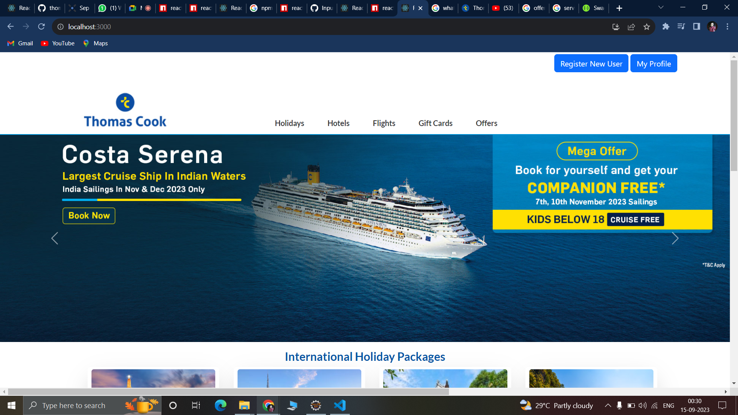
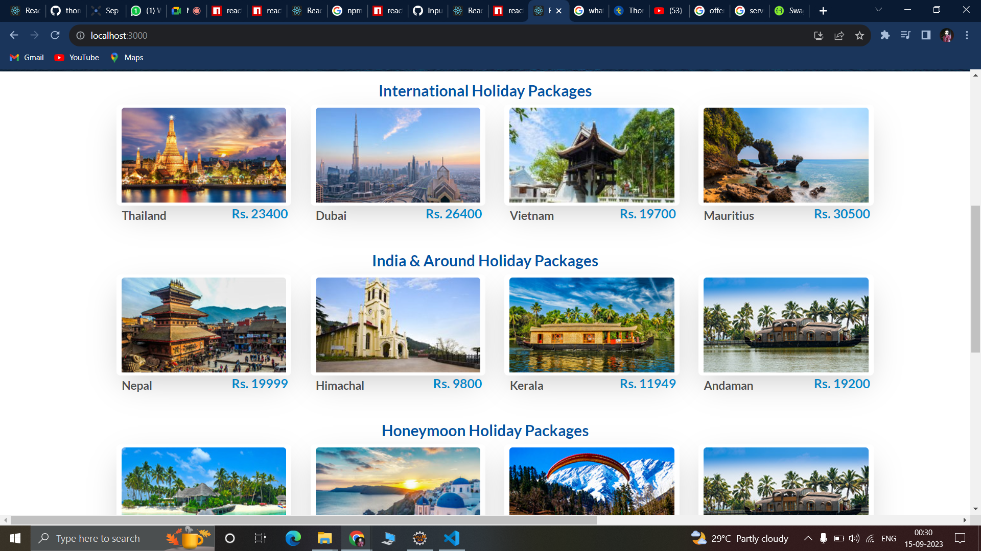

Preview of Landing Page

Slide 16
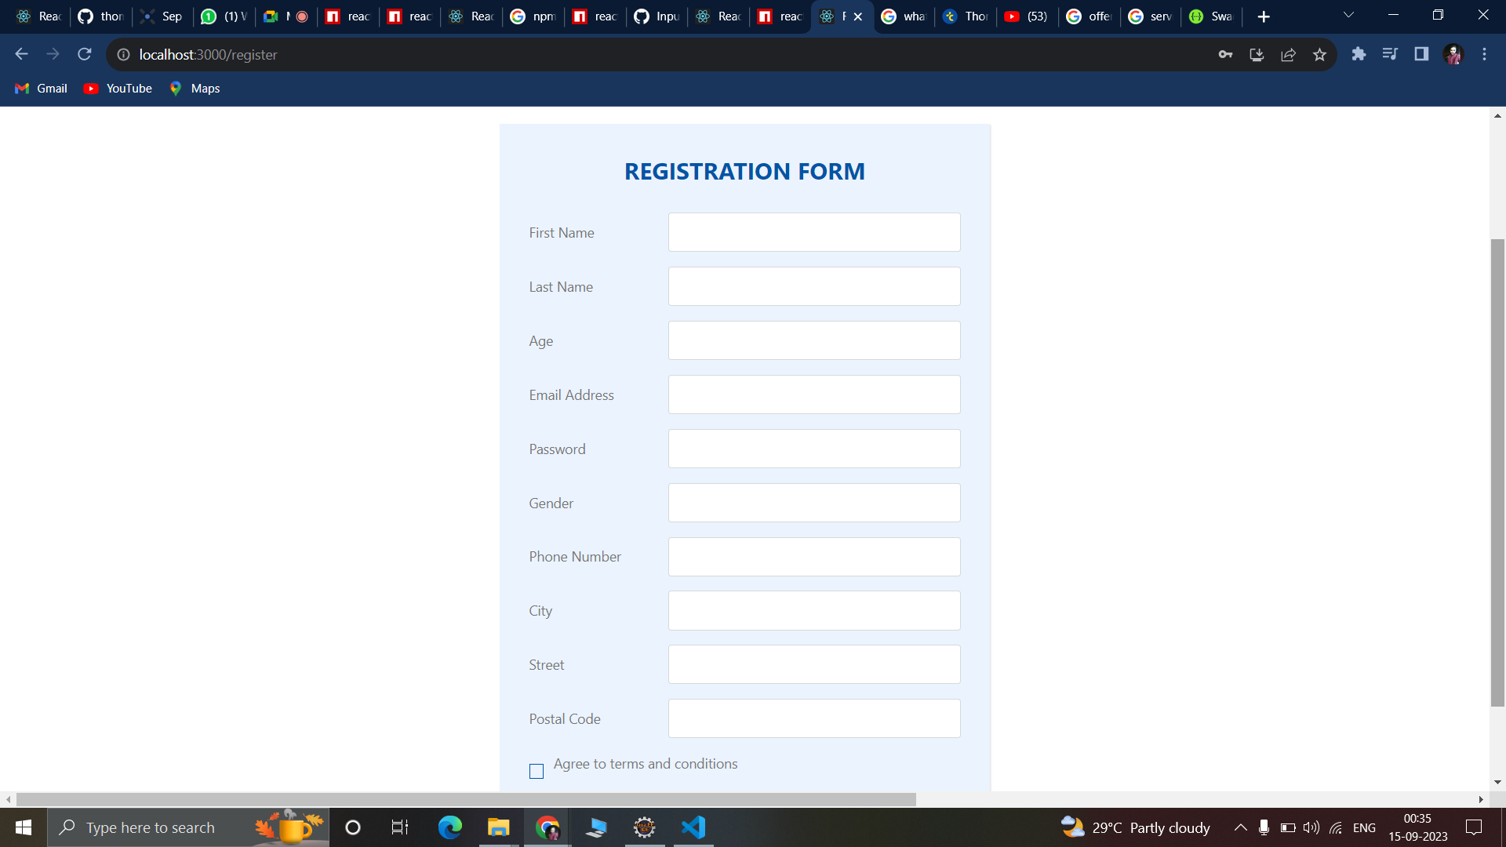
Preview of Registration Page

Slide 17
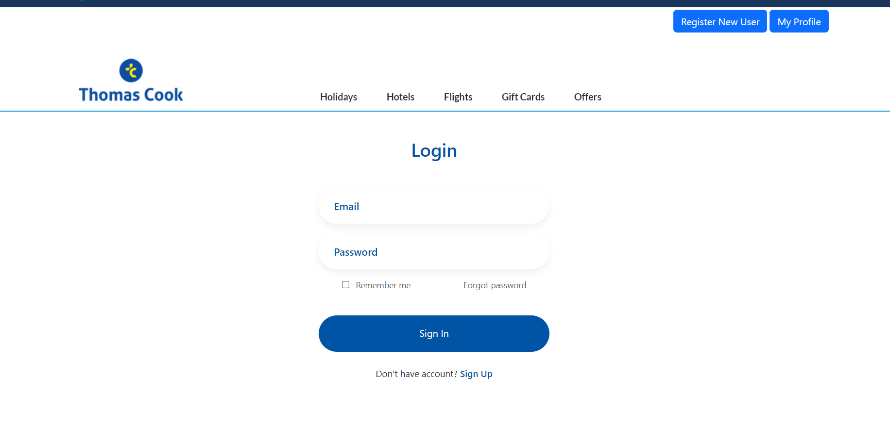
Preview of Login Page

Slide 18
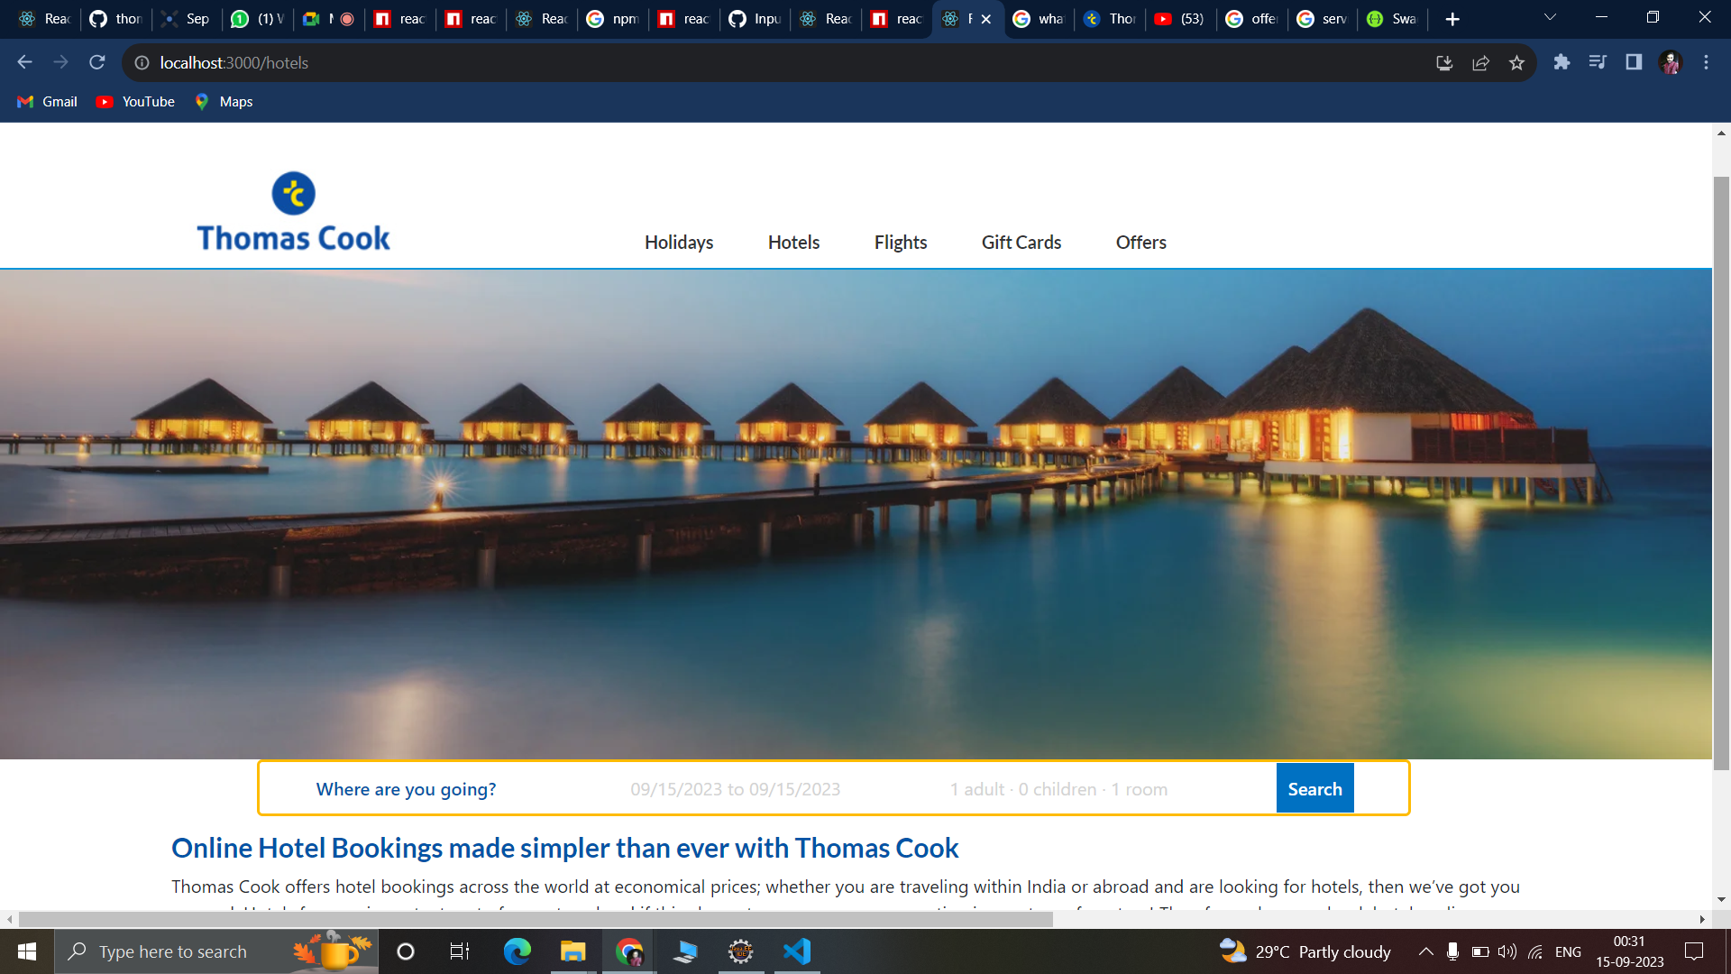
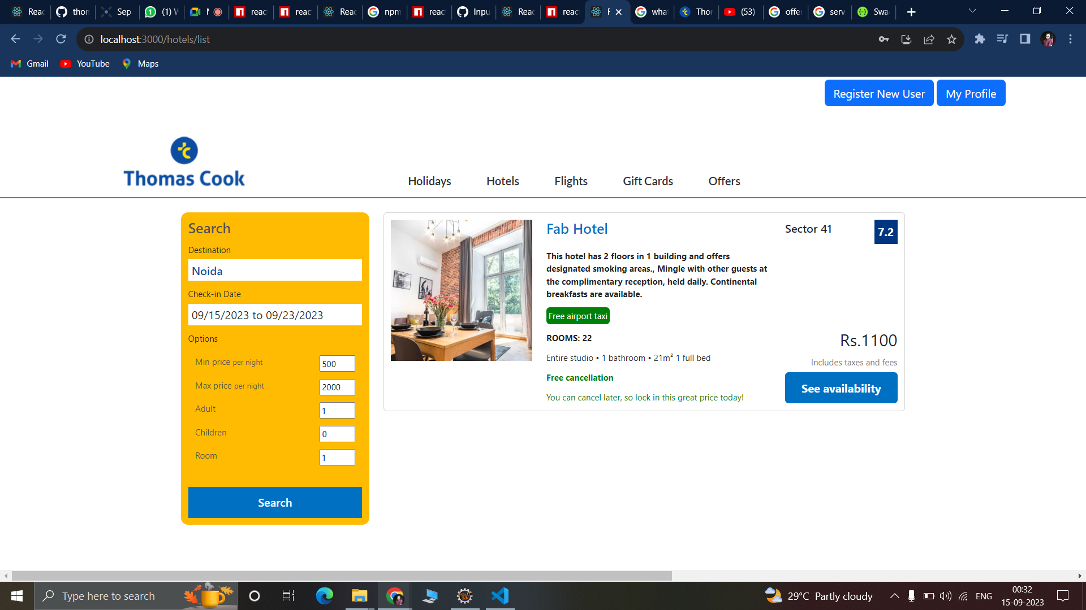
Preview of Hotel Search Page

Slide 19
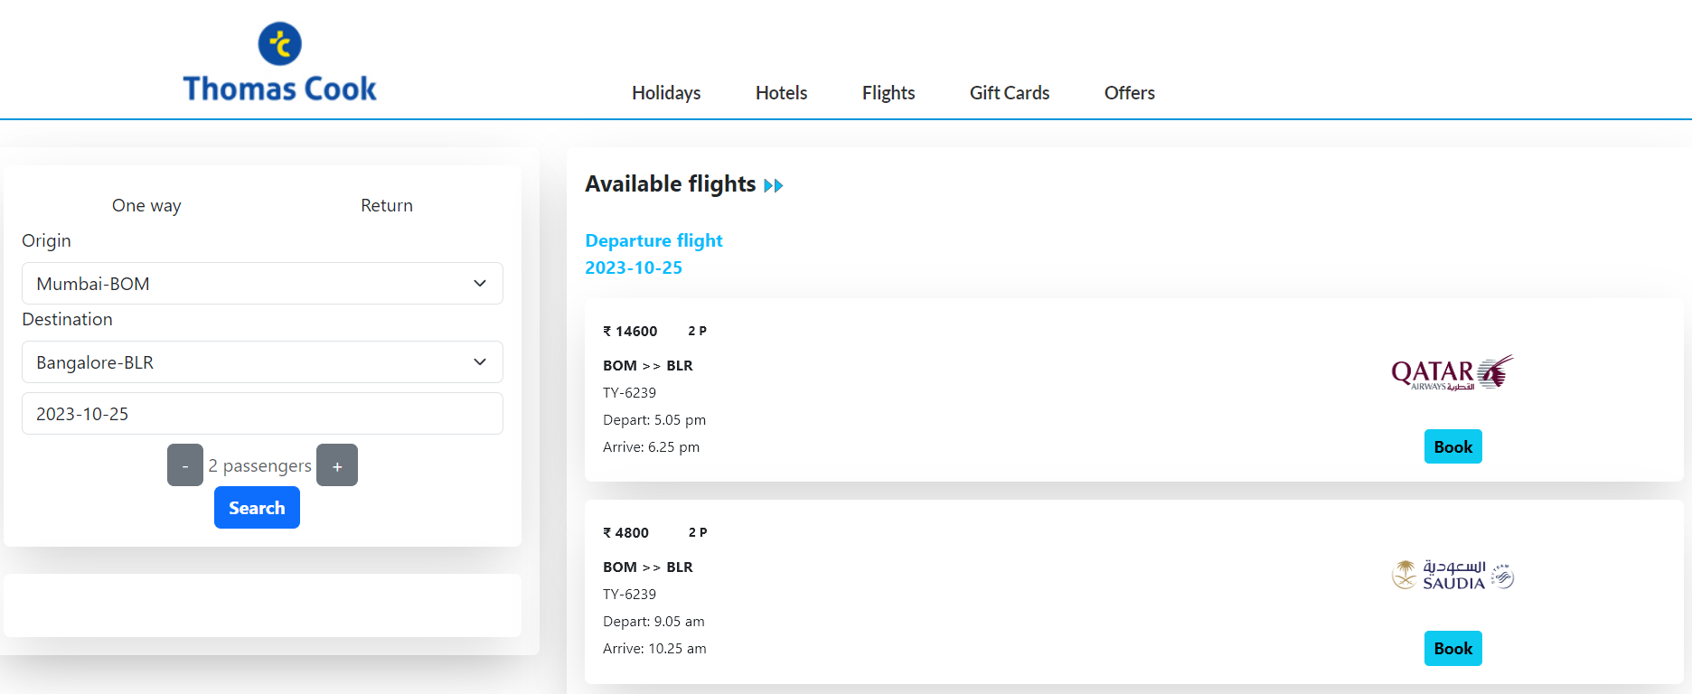
Preview of Flight Search Page

Slide 20
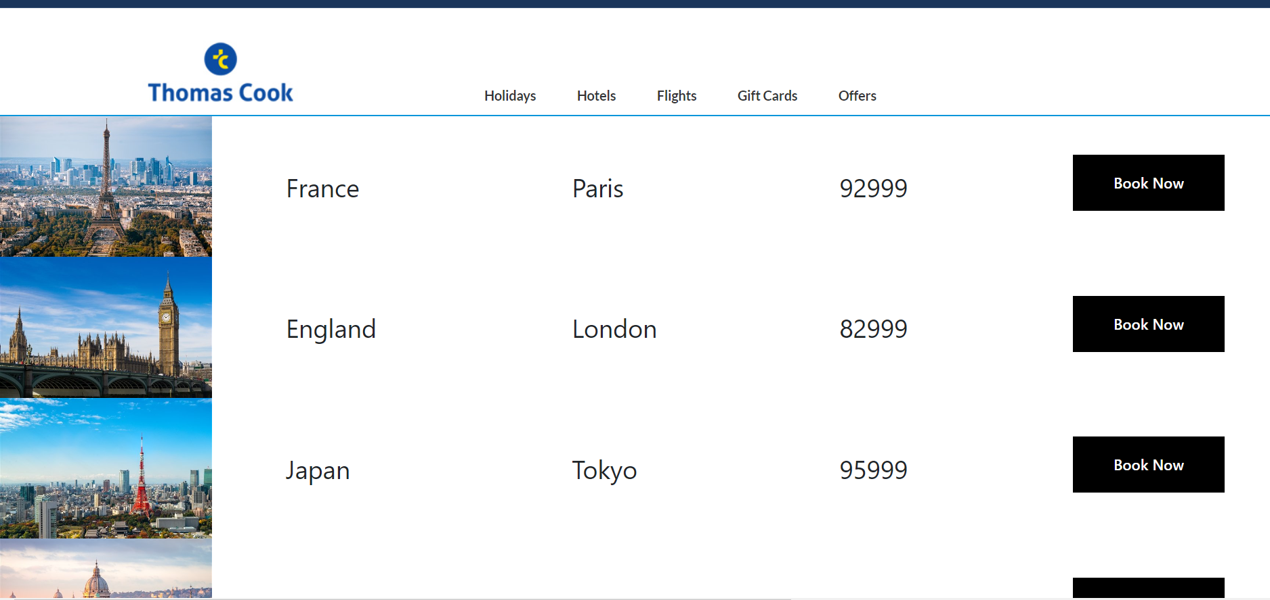
Preview of Holiday Search Page

Slide 21
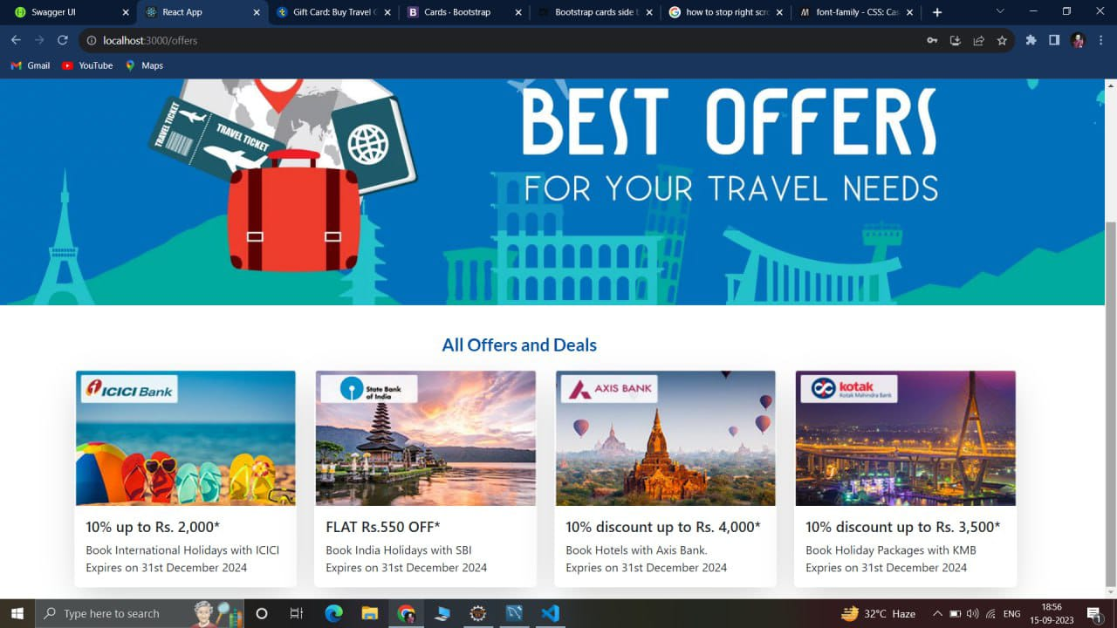
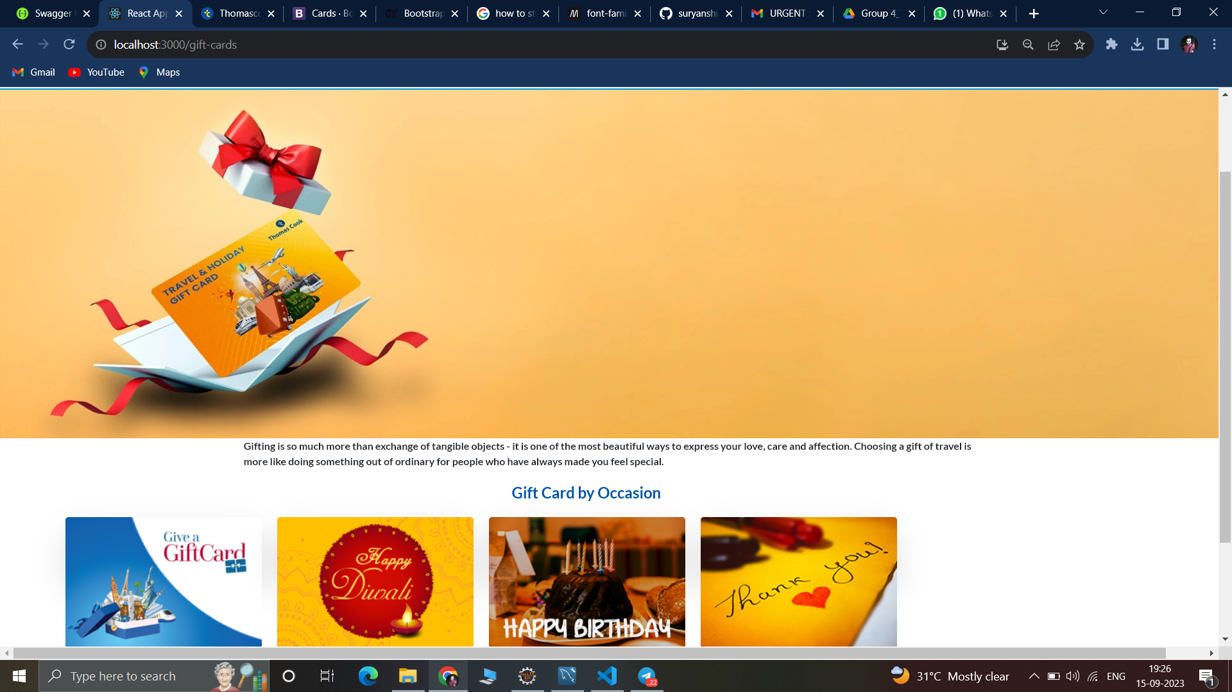
Preview of Gift Card Page

Slide 22

Challenges
&
Learnings
Challenges:
Time Constraints:
Managing the deadline of 3 weeks proved to be a significant challenge.
The pressure to deliver a fully functional clone within a specified timeframe required meticulous planning and prioritization.
Full Stack Development with a Large Team:
This project marked the first experience for many team members in working on a full-stack development project.
Coordinating efforts among a large team with diverse skill sets and responsibilities presented collaboration and communication challenges.
Integration of Frontend with Backend:
Ensuring seamless integration between the frontend and backend modules was a complex task.
Maintaining data consistency and real-time updates across the system required careful design and testing.
Third-Party Integrations:
Integrating external services such as Razorpay payment gateways and real-time data providers posed challenges.
Compatibility issues and learning curves added complexity to the project.
Learnings:
Effective Time Management:
The project reinforced the importance of meticulous time management, including setting realistic deadlines and monitoring progress regularly.
Communication and Collaboration:
Working with a large team highlighted the value of clear and frequent communication.
Division of Work:
Breaking down tasks into manageable units and assigning them to team members according to their expertise and strengths led to more efficient development.
Documentation and Knowledge Sharing:
Comprehensive documentation and knowledge sharing sessions ensured that team members had access to critical information, reducing knowledge silos.
Feedback Loop:
Encouraging open feedback loops and learning from mistakes and successes promoted a culture of continuous improvement.

Slide 23


Conclusion
Despite the challenges, we are proud to announce the successful completion of the Thomas Cook Website Clone Project.
Throughout the project, we maintained a strong focus on providing a user-friendly, reliable, and feature-rich travel booking platform.
Our dedicated and diverse team worked collaboratively to overcome obstacles, demonstrating the power of teamwork.
Many team members gained valuable experience, including full-stack development, teamwork, and problem-solving, which will benefit future projects.
We acknowledge the importance of time management, communication, and documentation in project success.
We have a roadmap for future enhancements, including additional features and services to expand our website's capabilities.
We extend our heartfelt thanks to our team members, fellow IAP interns, and L&D Team for their support and contribution to this project.

Slide 24
Thank You
"We greatly appreciate your time and attention."
"Thank you for being a part of this presentation.“
If you have any questions, feedback, please don't hesitate to ask us. We value your input.

